Slide 1
TEACHER’S PERSONAL INFORMATION
Name: Nguyen Thanh Loan
Facebook: Loan Nguyễn Thanh
Mobile number: 0942 255 937
Email: loannguyenthanh1978@gmail.com

Slide 2

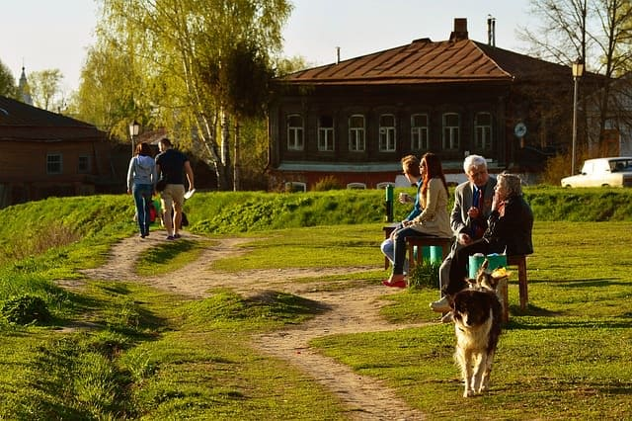
UNIT 9
WHAT IS THE ALTERNATIVE?

Slide 3
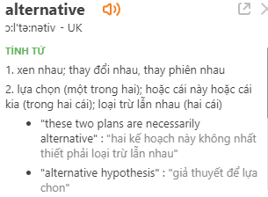
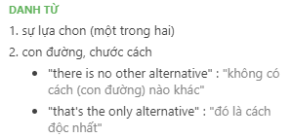
Alternative
/ɔːlˈtɜːnətɪv/
An alternative plan or method is one that you can use if you do not want to use another one
Ex: The opposition parties have so far failed to set out an alternative strategy.

Slide 4
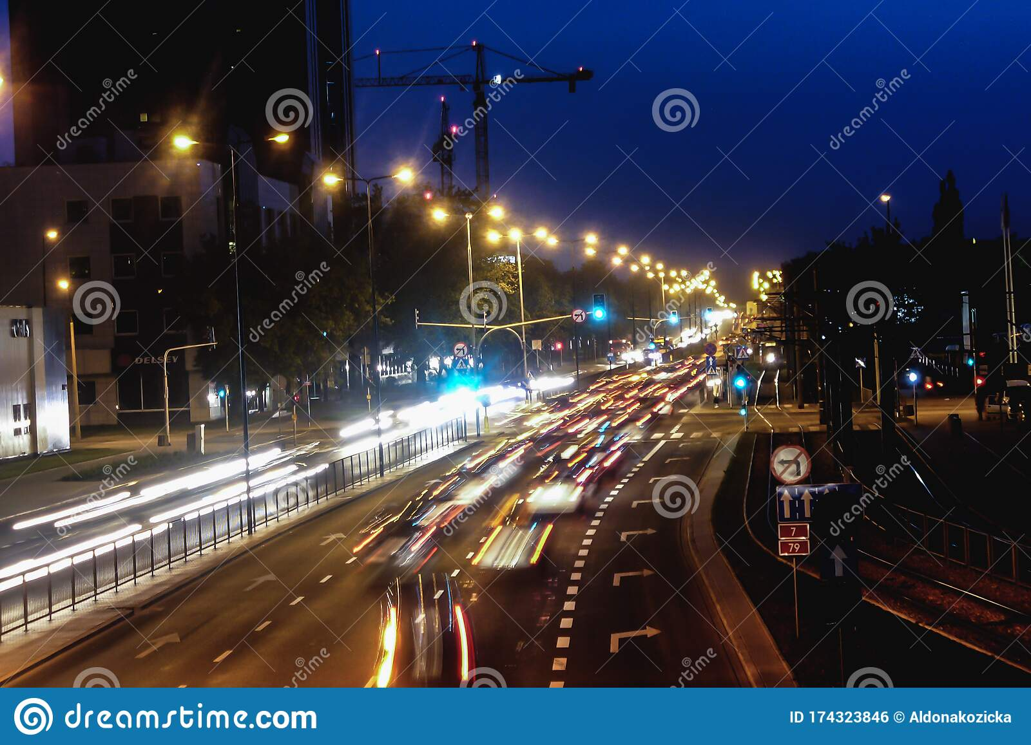
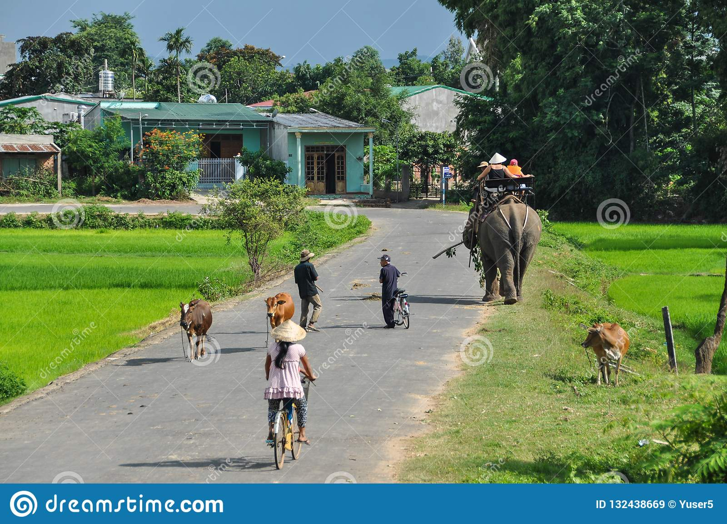
CONTENTS
Vocabulary: the cost of living, farming, health
Grammar: VERBS+ -ING, present simple and past simple passive, subject/object questions
Function: managing a conversation.

Slide 5
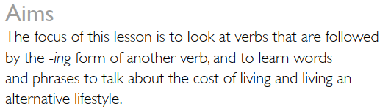
LESSON 1
LIVING OFF THE GRID

Slide 6

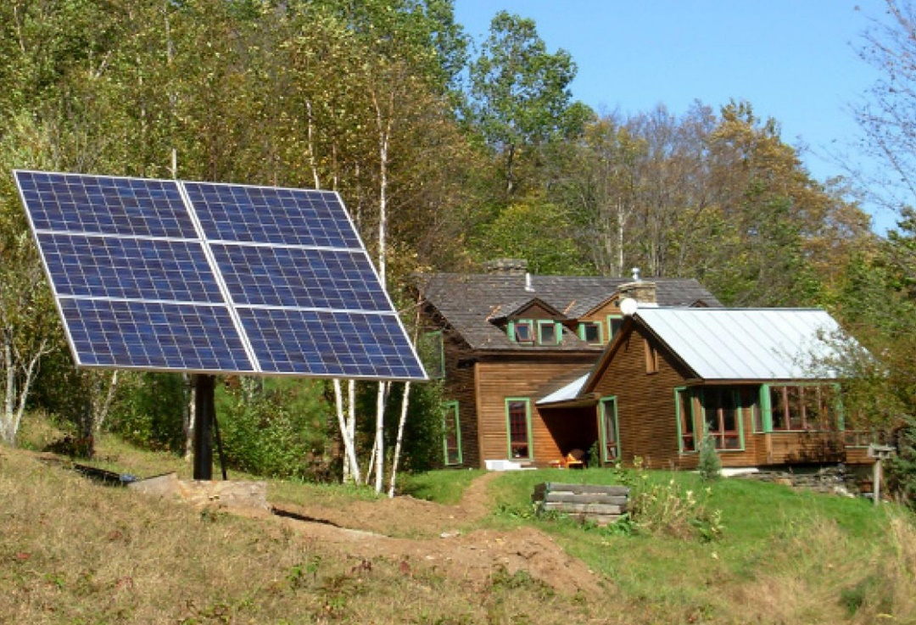
VOCABULARY
THE COST OF LIVING
Electricity grid /ɪˌlekˈtrɪsəti/
Off-grid power
(off Electricity grid)

Slide 7

VOCABULARY
THE COST OF LIVING
Public utilities
/ˌpʌblɪk juːˈtɪləti/
ngành dịch vụ công cộng (cấp nước, điện, mạng lưới xe búyt..), dịch vụ công cộng, ngành công ích, ngành phục vụ công cộng
Public utilities such as water, gas and electricity come under the control of the government.

Slide 8

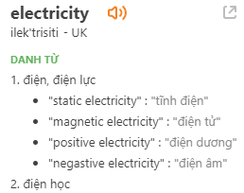
VOCABULARY
THE COST OF LIVING

Slide 9

VOCABULARY
THE COST OF LIVING
Water supply
/ˈwɔː.tə ˌsəˈplaɪ/
the water that is provided and treated for a particular area

Slide 10

VOCABULARY
THE COST OF LIVING
Solar panel
/ˌsəʊ.lə ˈpæn.əl/
a panel designed to absorb the sun's rays as a source of energy for generating electricity or heating.
Ex: Solar panels are used to power satellites.

Slide 11
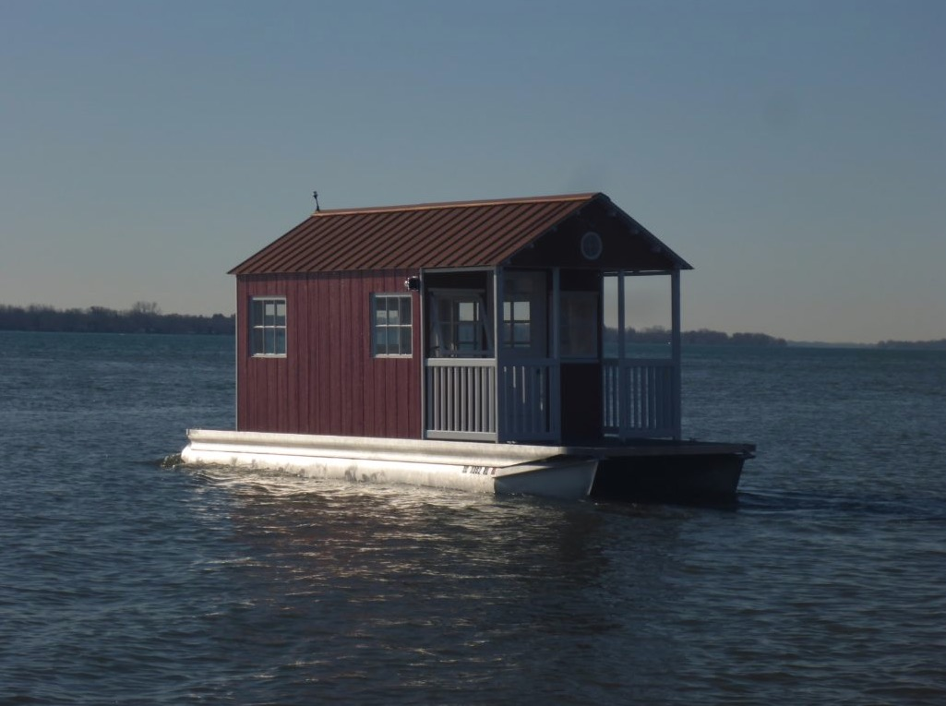
VOCABULARY
THE COST OF LIVING
Float house
/fləʊt haʊs/

Slide 12

VOCABULARY
THE COST OF LIVING
Wind generator
/wɪndˈdʒen.ər.eɪ.tər/
máy phát điện bằng sức gió

Slide 13

VOCABULARY
THE COST OF LIVING
Retired couple
/rɪˈtaɪəd /ˈkʌp.əl/

Slide 14


VOCABULARY
THE COST OF LIVING
To pay rent
Have a mortgage
/ˈmɔː.ɡɪdʒ/
trả tiền thuê
có một thế chấp

Slide 15
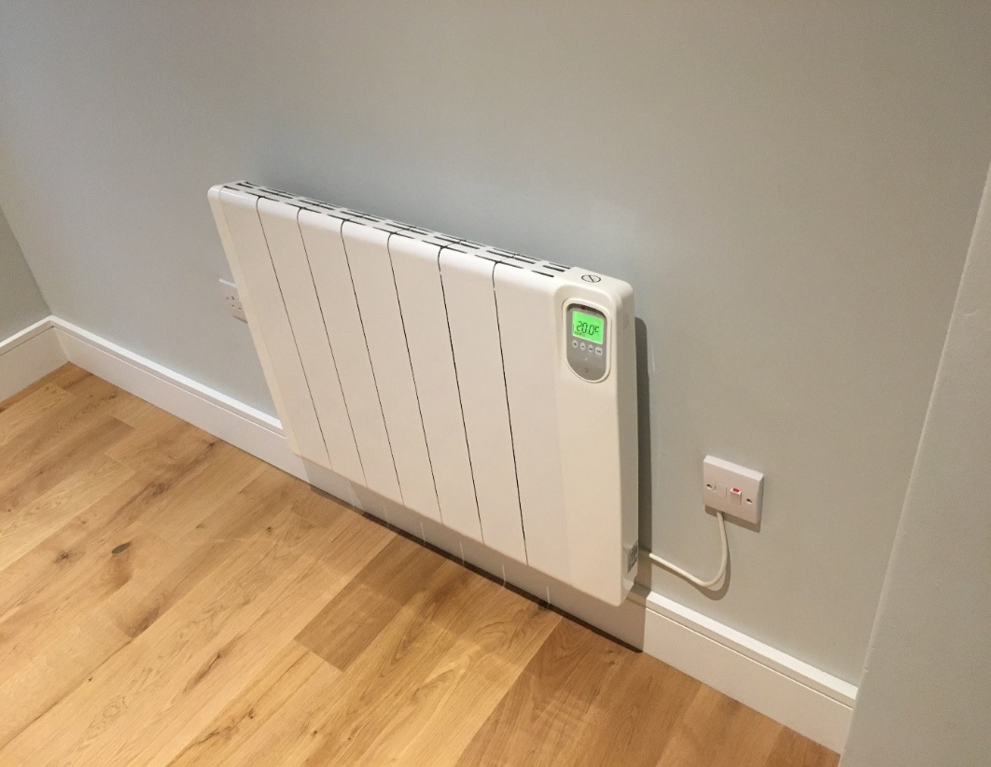
VOCABULARY
THE COST OF LIVING
Central heating
/ˌsen.trəl ˈhiː.tɪŋ/
a system for warming a building by heating water or air in one place and circulating it through pipes and radiators or vents.
(hệ thống làm ấm tòa nhà bằng cách làm nóng nước hoặc không khí tại một nơi và lưu thông qua đường ống và bộ tản nhiệt hoặc lỗ thông hơi)

Slide 16
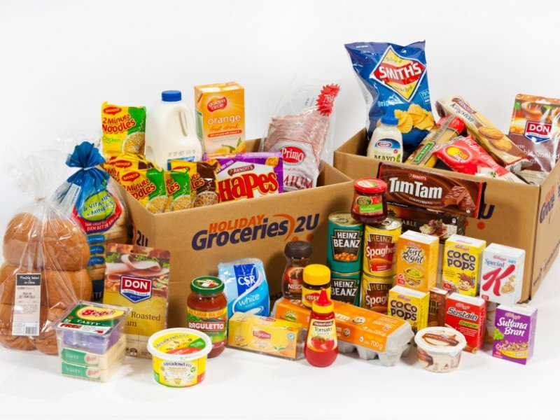
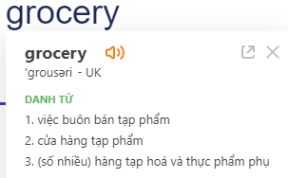
VOCABULARY
THE COST OF LIVING
groceries

Slide 17

VOCABULARY
THE COST OF LIVING
Living cost
the amount of money that a person needs to live
Ex: The increase in interest rates will raise the cost of living.

Slide 18

Can you remember the words and phrases?

Slide 19



Slide 20


Slide 21
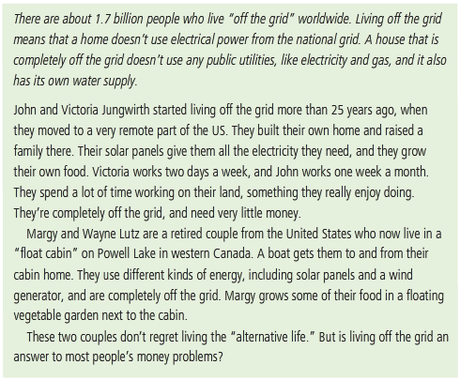
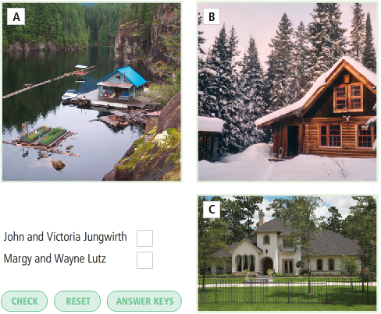
READING
LIVING OFF THE GRID
Read the rest of the article about the two couples and decide who they are (John or Margy).

Slide 22

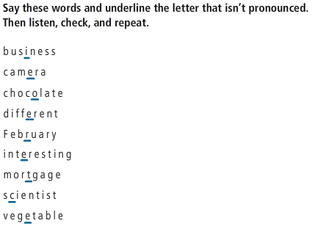
PRONUNCIATION

Slide 23
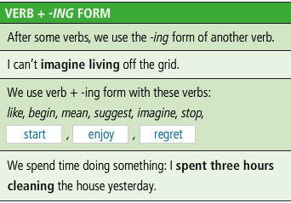
READING
VERB + ING FORM

Slide 24
READING
VERB + ING FORM

Slide 25
GRAMMAR
VERB+ -ING FORM
We use the “Verb + -ing form” after the following verbs:
 | Verbs | Examples
1 | begin | They began moving to this house in 1997.
2 | Enjoy | My sister enjoys watching horror films.
3 | Imagine | I can’t imagine living off the grid.
4 | Like | Do you like playing sports?
5 | Mean | If we want to catch the 7.30 train, that will mean leaving the house at 6.00
6 | Regret | I have always regretted not having studied harder at school.
7 | Spend | He spends two hours a day practicing English.
8 | Start | They started building the house in January.
9 | stop | I couldn't stop laughing
10 | suggest | I suggested putting the matter to the committee.

Slide 26
PRACTICE
Complete the sentences. Choose from these verbs and phrases or use other verbs.
Buy an apartment have a washing machine pay rent live in a mobile home watch TV work
To me, modern life means_________.
I spend ______ hours a week _________.
I don’t regret _______ .
Can you imagine________?
I started _______ ago/
I’d like to stop ______.
Recently a friend of mine suggested _______ together.

Slide 27
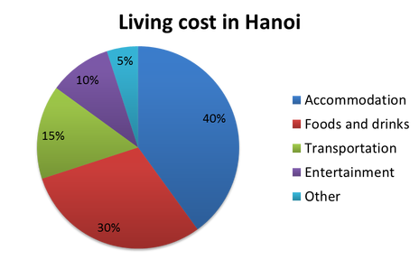
SPEAKING
Discuss the questions
What is your biggest living cost?
2. What are the ways to reduce living cost?
3. What changes will you make?

Slide 28
No |  | Monthly | Percentage
1 | Accommodation | 1.000.000 | 20%
2 | Food & Drink | 1.000.000 | 20%
3 | Education | 500.000 | 10%
4 | Digital Entertainment | 300.000 | 6%
5 | Hang out | 300.000 | 6%
6 | Transportation | 500.000 | 6%

Slide 29
REFERENCES
Vocabulary: Cost of living
https://www.youtube.com/watch?v=rlJzs58eNcg
Grammar: V-ing form
https://www.youtube.com/watch?v=uaid9kHmHbw

